Slide 1
The Enigmatic Enzyme
By Atul Khosla

Slide 2
Problems in Healthcare
The Healthcare industry is one with a myriad of problems, some of which are:
Telehealth
Accessibility
Scheduling
Keeping track of patients
I shall demonstrate how the website I have developed, “The Enigmatic Enzyme”, helps to overcome each of these issues in the healthcare industry…

Slide 3
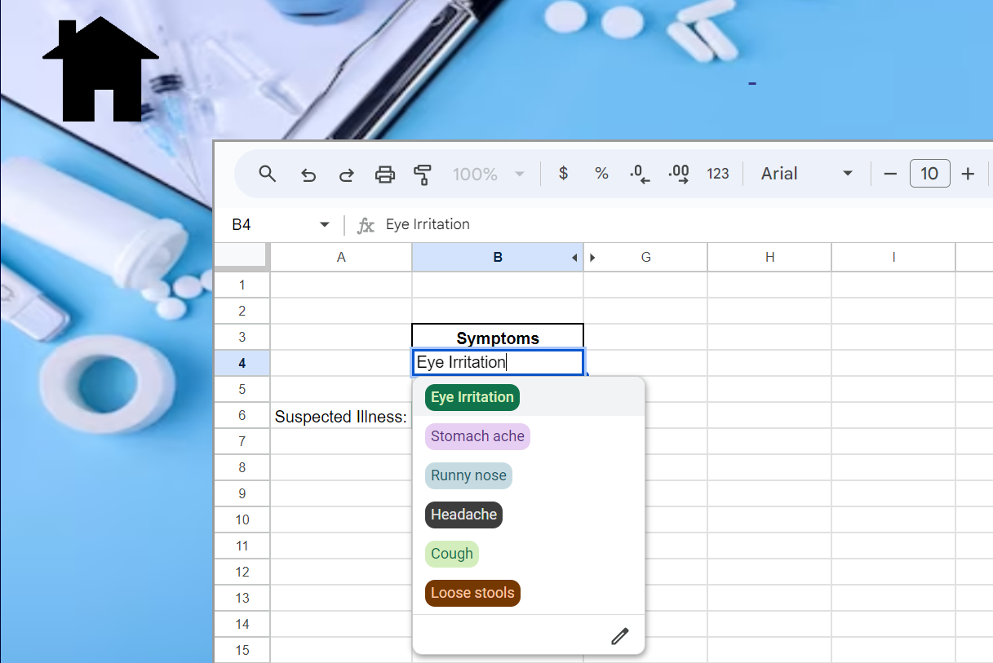
Telehealth
One big problem of the healthcare industry is telehealth, which is the distribution of healthcare services over telecommunication technologies.
The simplistic design of my website allows patients to enter some common symptoms they may have. The system then matches this with a list of possible diseases and conveys this to the user, providing some basic information to patients if there are no doctors available in their nearby areas.

Slide 4
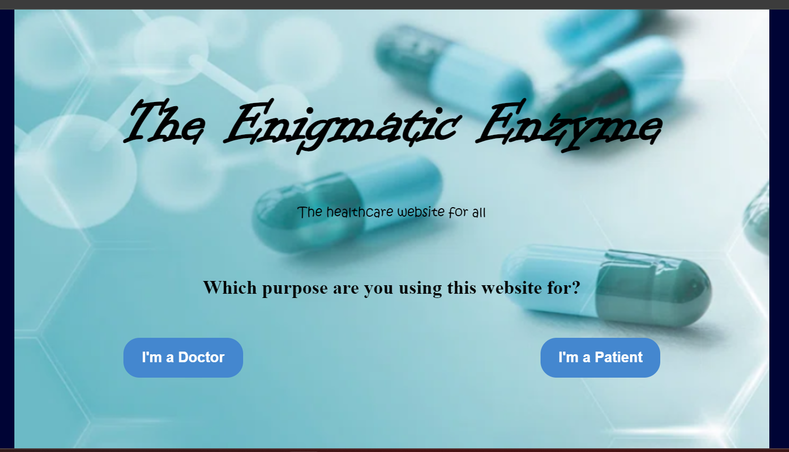
Accessibility
The convenient and easy-to-use User Interface of the website makes it very accessible for all users, and not intimidating for technophobes or older generations.
The website can be used and navigated easily by anyone, providing a basic healthcare facility for all.

Slide 5
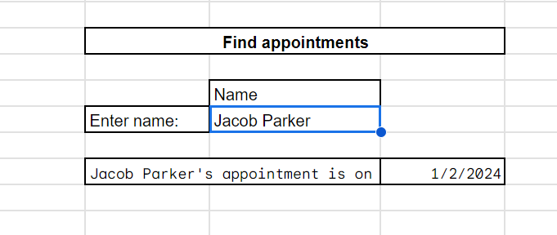
Scheduling
Scheduling appointments is a constant and monotonous challenge for doctors.
My website provides a simple system so that doctors can easily look up patients and their respective appointments by simply entering the name of the patient.

Slide 6
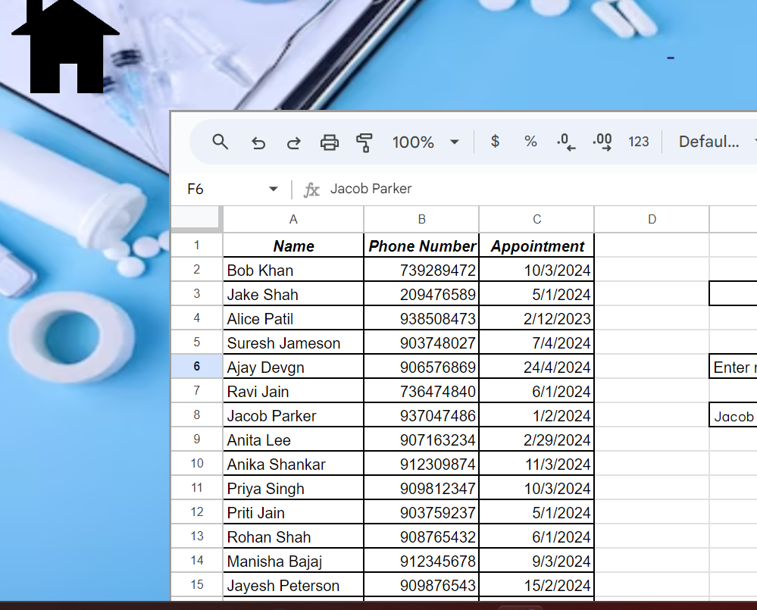
Keeping Track of Patients
Yet another problem for doctors can be keeping track of patients.
My website provides a database system for doctors to enter the data for their patients. This helps them easily keep track of their patients and their corresponding data, without the need of extra books or paperwork, saving resources as well as desk space.

Slide 7
THANK YOU

